Slide 1

VIETNAM NATIONAL UNIVERSITY – HO CHI MINH CITY
UNIVERSITY OF INFORMATION TECHNOLOGY
DS310
NATURAL LANGUAGE PROCESSING
For Data Science
Faculty of Information Science and Engineering
University of Information Technology, VNU-HCM
UIT, VNU-HCM
NLP for Data Science

Slide 2


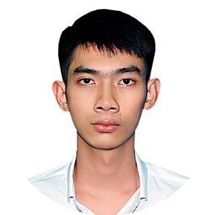
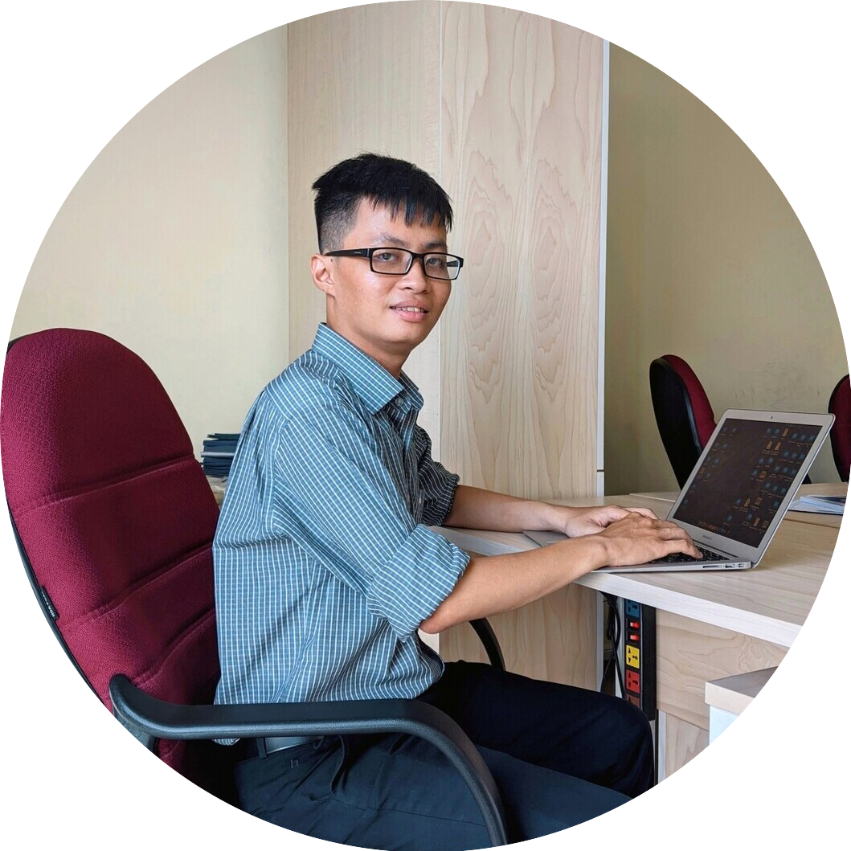


Who are we?
ThS. Nguyễn Văn Kiệt
Giảng viên
PTK KH&KTTT
TS. Nguyễn Lưu Thùy Ngân
Giảng viên
PHT Trường ĐH CNTT
ThS. Nguyễn Đức Vũ
Nghiên cứu viên, MMLAB-UIT
CN. Lưu Thanh Sơn
Trợ giảng
CN. Huỳnh Văn Tín
Trợ giảng
Nguyễn Thành Luân
Trợ giảng SV

Slide 3
Research Interests
Natural Language Processing
  ▫ AI.
  ▫ Computational Linguistics.
  ▫ Applications in DS.
Text Processing.

Slide 4
This course’s contents
  NLP Core
    Basic NLP concepts
    NLP pipeline: Word → POS → Parsing
    NER
    ML/DL
  NLP Applications
    Text Classification, Sentiment Analysis
    Information Extraction
    Question Answering, Chatbot
UIT, VNU-HCM
NLP for Data Science

Slide 5
Evaluation
  Progress: 20%.
    Attendance, listening, respecting lecturers and friends and debating peacefully
    Quiz.
  Labs: 30%.
    Depending on the quantity and quality of your labs submitted.
  Final examination: 50%
    Project.
      Writing report: 25%
      Presentation: 25%
UIT, VNU-HCM
NLP for Data Science

Slide 6
Course Objectives
  G1: Understand and apply basic concepts and techniques in NLP.
  G2: Understand and apply ML/DL to processing natural language.
  G3: Understand, apply and evaluate several NLP applications.
UIT, VNU-HCM
NLP for Data Science

Slide 7
Final Project
  Group: 2-3 students
  Beginning: 3rd week
  Requnirements:
    Students must have weekly progress report
    Implementing only 01 NLP project.
UIT, VNU-HCM
NLP for Data Science

Slide 8
Requirements
  Slides: in English/Vietnamese.
  Lecturer: teaching in Vietnamese
  Students: should take note in learning and teaching process
UIT, VNU-HCM
NLP for Data Science

Slide 9
Contact us!
  If you have any problem in your learning process and in your project, please feel free to contact us:
    Room: 10.2, 10th Floor, Block E, UIT.
    Time: 9h00 – 10h00, Tuesday.
    Note: Please notify your meeting with me before at least 01 day.
UIT, VNU-HCM
NLP for Data Science

Slide 10
Q&A
UIT, VNU-HCM
NLP for Data Science

Slide 11
  Thank you!
UIT, VNU-HCM
NLP for Data Science

